Slide 1


Strategies for Audiovisual Digitization Projects
Effective Outsourcing with Audiovisual Digitization Service Providers
Wednesday, June 14, 2017
Moderator:
Wayne Graham
Technical Director, CLIR
Kathy O’Regan
Bay Area Video Coalition
kathyoregan@bavc.org
Diana Little
The MediaPreserve
little@themediapreserve.org
Jan Jones
Memnon Archiving Services
jan.jones@memnon.com
Bryce Roe
Northeast Document
Conservation Center
broe@nedcc.org

Slide 2
Background

Slide 3

Background
Fig 1. “ Degradation”
Fig 2. “ Obsolescence”

Slide 4

Agenda
Fig 1. “ Degradation”
Lightning talks
Fig 2. “ Obsolescence”

Slide 5
Agenda
Fig 1. “ Degradation”
Lightning talks
Fig 2. “ Obsolescence”
Moderated discussion

Slide 6
Agenda
Fig 1. “ Degradation”
Lightning talks
Fig 2. “ Obsolescence”
Moderated discussion
Q & A

Slide 7

Bay Area Video Coalition
Effective Outsourcing with Audiovisual Digitization Service Providers
Digital Library Federation Webinar, Wednesday, June 14th
Kathy Rose O’Regan, Preservation Manager, Bay Area Video Coalition

Slide 8

BAVC - A Bay Area Community Hub
Operational for 40 years +
Non-Profit
Bay Area community hub for all things media
Focus on education, content creation, and preservation
Inclusive, diverse, welcoming and safe environment

Slide 9

BAVC Preservation
Fully monitored transfers
Archivist staff members
Non Profit
23 Years of proven experience

Slide 10
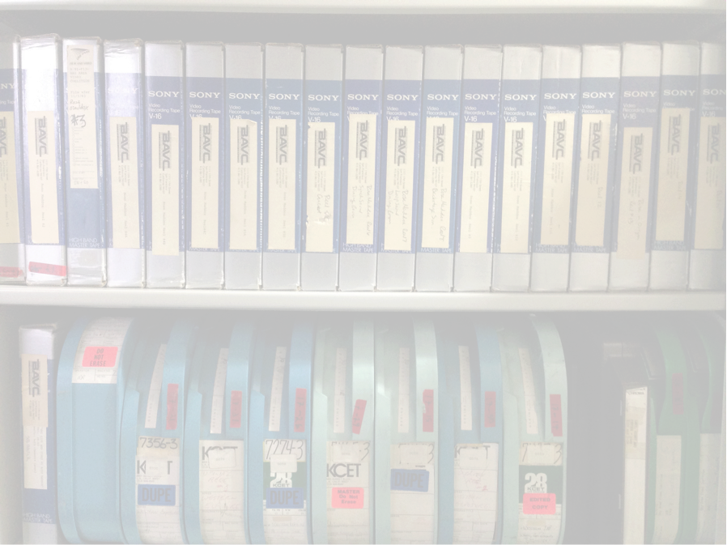
Who Is BAVC Preservation?
Part of BAVC’s Engagement Department
Small, passionate staff
Three full time staff members
Two contracted preservation technicians
One on call equipment technician

Slide 11
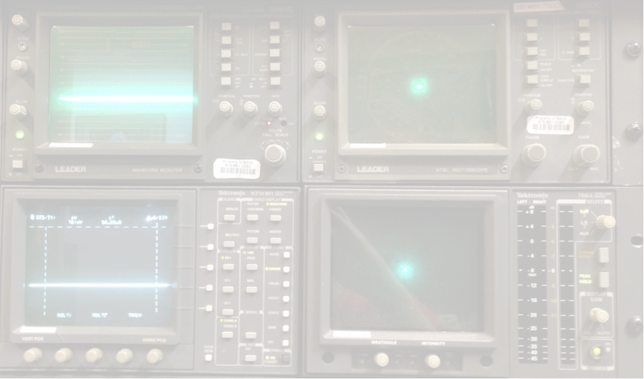
Services We Provide
Digitization of a wide variety of videotape formats
Digitization of limited audio formats
Collection assessments
Tape cleaning and baking
Preservation consultations

Slide 12

How We Insure Quality
Staff trained in archival and preservation best practices
Wide selection of professional decks
Time base correctors and analog and digital scopes used to ensure transfers of the highest possible fidelity
Work with dedicated maintenance engineers
Extensive Quality Control

Slide 13
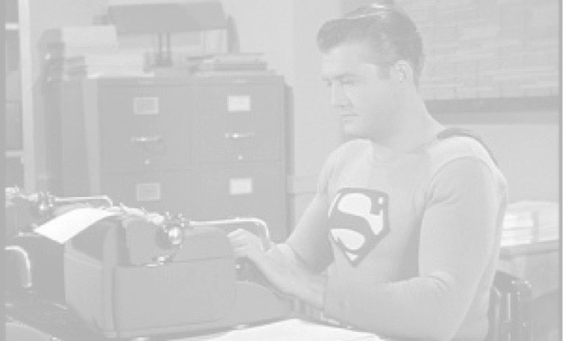
Your Request for Proposal
Clarity
Specificity
Know your needs
Know your collection - and its condition!

Slide 14
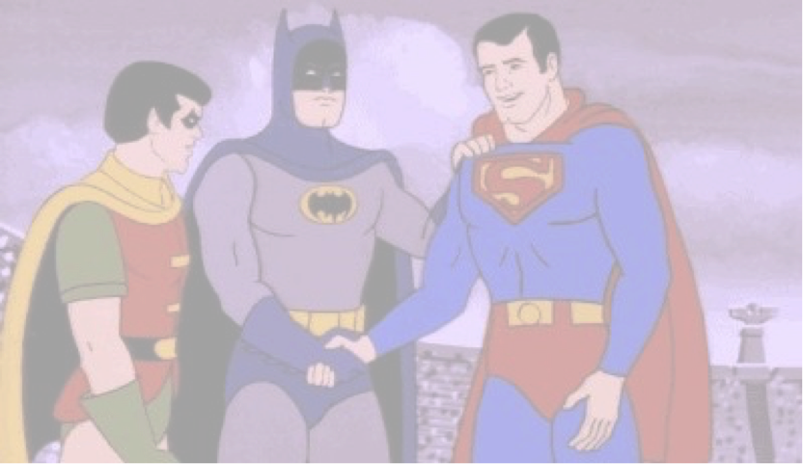
How To Help Your Vendor
Maintain open lines of communication with your vendor’s point of contact throughout project
Ask as many questions as necessary to ensure project workflow is successful
Ask for examples of vendor work previous to beginning of project

Slide 15

Helping You Over Hurdles
Dedicated archivist staff members
Personal client interaction
Grant writing professionals on staff
Assessment and advice

Slide 16
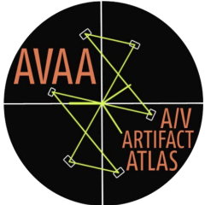



BAVC Tools (Freeeeee!)
QC Tools
SignalServer
AV Artifact Atlas
AV Compass

Slide 17

Resources
https://bavc.org/preserve-media
https://github.com/bavc/qctools
https://github.com/bavc/signalserver
https://bavc.github.io/avaa/
http://www.avcompass.bavc.org/
https://archive.org/details/@bavc_preservation_dept

Slide 18
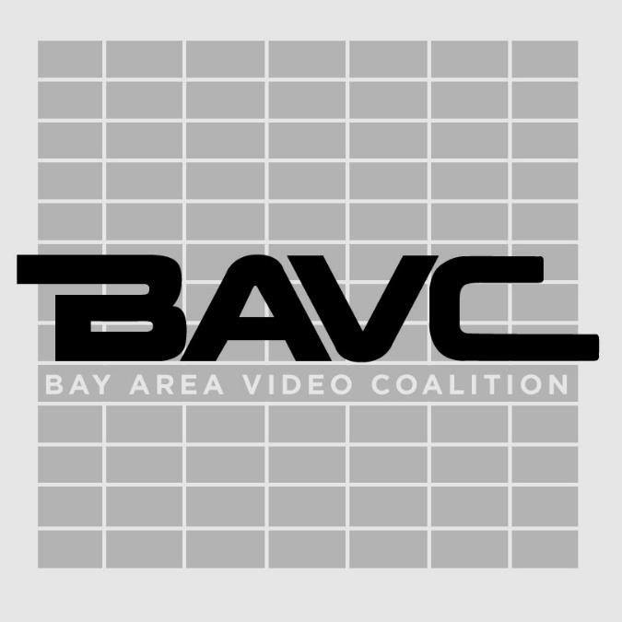
THANK
YOU!

Slide 19
Film Scanning at
Diana Little
Head of Film Preservation
little@themediapreserve.com
Notes:
Hello from the MediaPreserve in Pittsburgh, PA! We are a full-service audiovisual preservation lab, as the name implies, but today I’m going to focus briefly on film, which is my area of expertise.

Slide 20
Formats
8mm
Super8
16mm
35mm
Notes:
If you have film in your collections, you’re likely to have these gauges, which were common amateur and production formats in the 20th century. If you have 16mm or 35mm, you might also have negative, soundtracks, and other pre-print elements, in addition to projection positives..

Slide 21
Formats
8mm
Super8
16mm
35mm
9.5mm
17.5mm
28mm
70mm
Notes:
And it’s less likely, but you might have some of these other formats.

Slide 22
Workflow
Or, how a film becomes a file
Notes:
I’ll go over our basic workflow at The MediaPreserve.

Slide 23
Check in
2. Inspection & prep
3. Cleaning
4. Scanning
5. Post production
6. QC & transcoding
7. Deliverables build… & deliver!

Slide 24
Equipment
Notes:
I’ll talk a bit about the equipment and methods we employ...

Slide 25
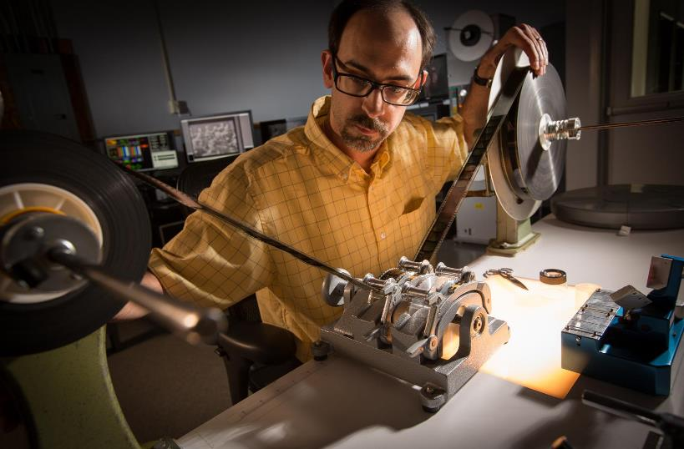
Equipment
Prep
Notes:
Every film is inspected on a rewind bench from head to tail, leader is added, damage is asssessed, repairs are made, and observations are recorded.

Slide 26
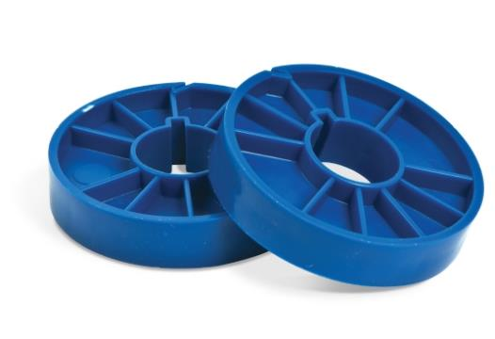
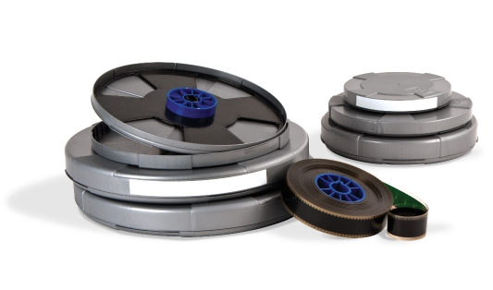
Equipment
Prep
Notes:
We wind all the films onto archival cores, and if there is a need or desire, we can recan films into vented polypropylene containers.

Slide 27
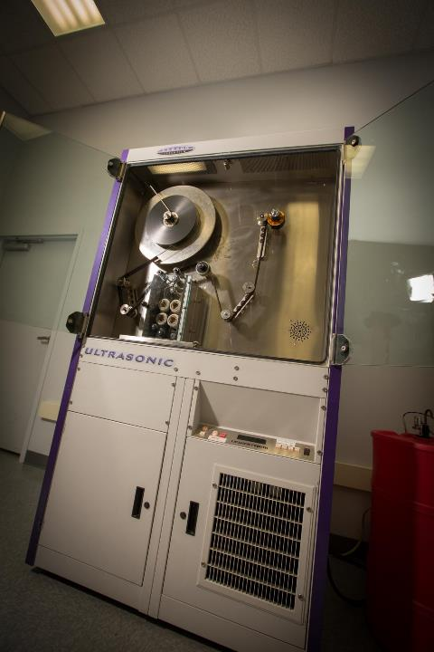
Equipment
Cleaning
Notes:
Most 16mm and 35mm films can be cleaned ultrasonically, using environmentally friendly HFE8200. Other gauges and delicate films are cleaned by hand, usually using the same solvent.

Slide 28
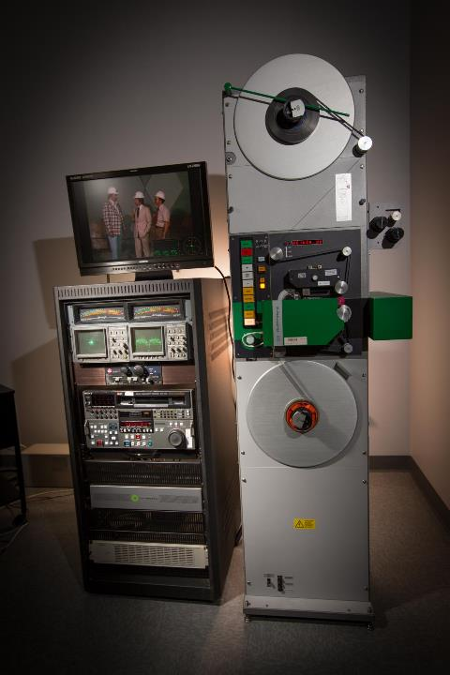
Equipment
Scanning
Notes:
Scanning equipment is chosen based on the film’s gauge and condition, and desired output formats. This is a Flashtransfer, which can digitize 16mm and associated soundtracks.

Slide 29
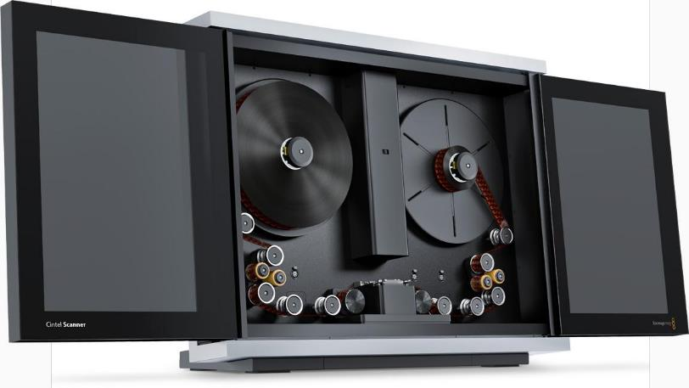
Equipment
Scanning
Notes:
This BlackMagic Cintel scanner can digitize 16mm and 35mm.

Slide 30
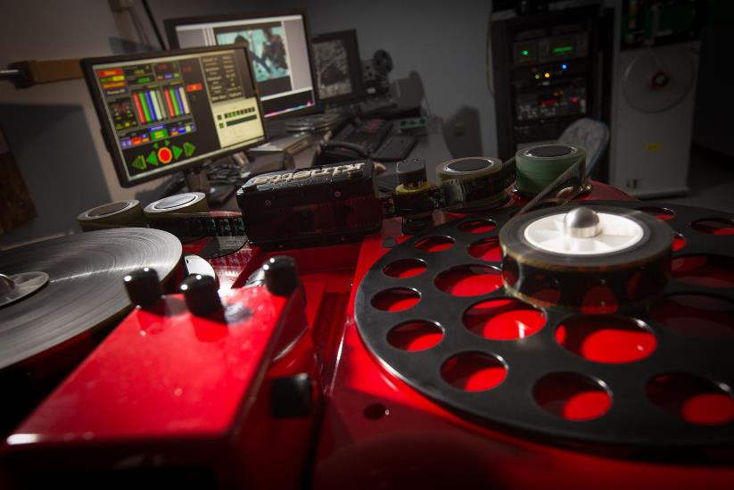
Equipment
Scanning
Notes:
This photo shows a Kinetta scanner, which can handle almost any type of film and is very gentle with shrunken and delicate assets.

Slide 31
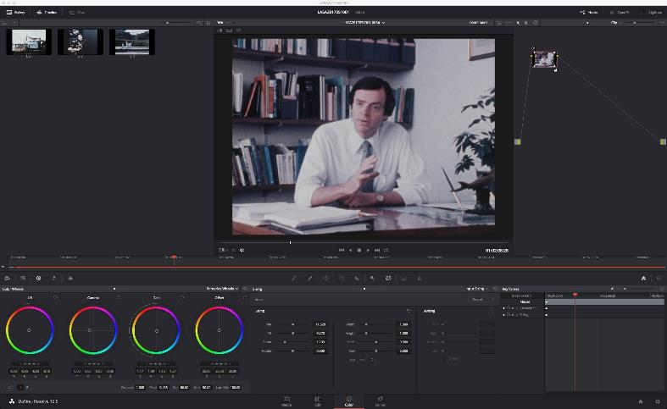
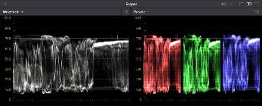
Post Production
Notes:
Most files require some post-processing after they are scanned, but the level of intervention is minimal and only intended to reproduce the experience of viewing the film on a projector. We primarily use BlackMagic’s DaVinici Resolve for color correction and associated processes.

Slide 32
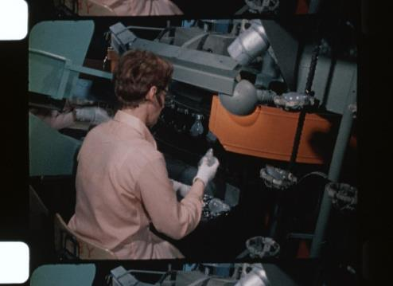
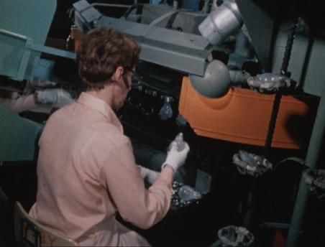
Post Production
Cropping
Notes:
This can include cropping, since some scanners capture information outside of the frame area.

Slide 33
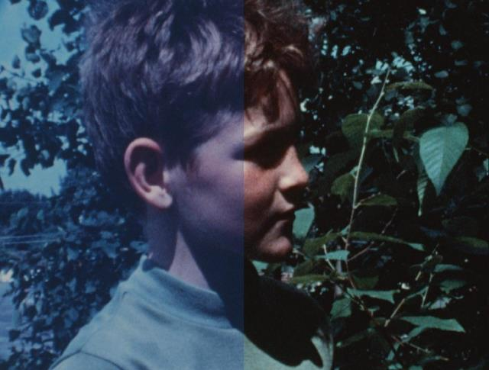
Post Production
Color Correction
Notes:
Color correction is usually necessary, but at a minimal level. Some faded films require a bit more color correction, though, to counteract dye fading over time. We can also perform speed adjustments and stabilization at this stage.

Slide 34
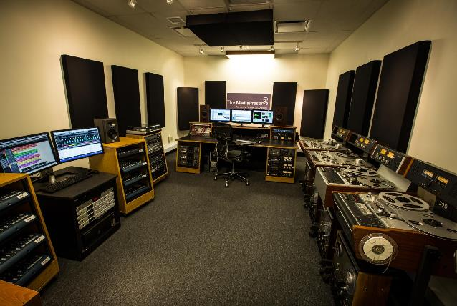
Audio & Video
Multiple Ingest
Notes:
But of course the MediaPreserve reformats more than just film, and magnetic media can be digitized at a higher volume than film. This is a typical audio studio, containing multiple ¼” Studer decks and Tascam cassette decks, as well as turntables, wire recorders and other playback equipment.

Slide 35
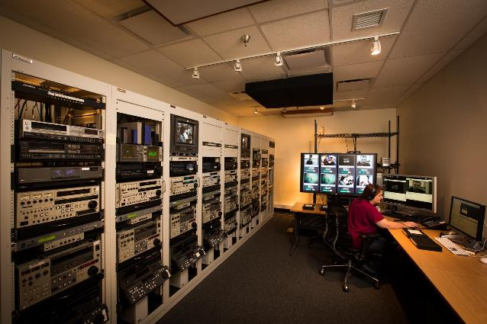
Audio & Video
Multiple Ingest
Notes:
This video studio contains 8 each of VHS, Umatic and BetaSP decks, but we can move in other playback devices for multiple ingest.

Slide 36
Checksums
QC
Derivatives
Metadata
Packaging and delivery
Notes:
There’s certainly a lot to talk about in terms of what happens after engineers create the master files, but it can’t all fit within this lighting talk, so I’m happy to answer questions here or outside the webinar.

Slide 37

Thanks!
The MediaPreserve
111 Thomson Park Drive
Cranberry Township, PA 16066
800.416.2665
info@ptlp.com
www.themediapreserve.com

Slide 38


Memnon Archiving Services
JUNE 2017

Slide 39

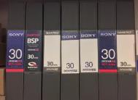

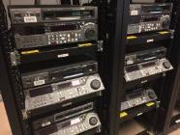
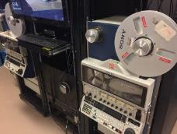
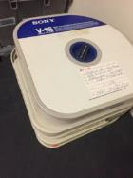
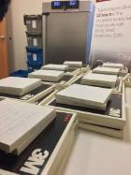
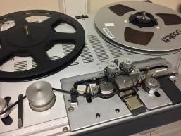
ABOUT MEMNON ARCHIVING SERVICES
Memnon offers a range of services to digitize, restore, preserve and provide access to audio-visual and cultural archives. We offer on-site, out-sourced or hybrid services to meet our clients needs.
Our unique workflow system is designed to ensure quality while allowing large volumes of materials to be preserved. Memnon’s services are suitable for a wide range of archive owners – from cultural institutions, libraries, universities and broadcasters.
Memnon has accrued nearly 20 years of experience working with audio-visual technology throughout in Europe, North America, Africa and the Middle East. Our workforce has evolved into a multi-disciplinary team of engineers, computer specialists, meta-data experts and project managers.
A Sony Company since 2015, Memnon now has access to large quantities of video tape players, spare parts and technical knowledge only available to Sony Group companies.
©2017 Memnon Archiving Services SA. All rights reserved
2

Slide 40


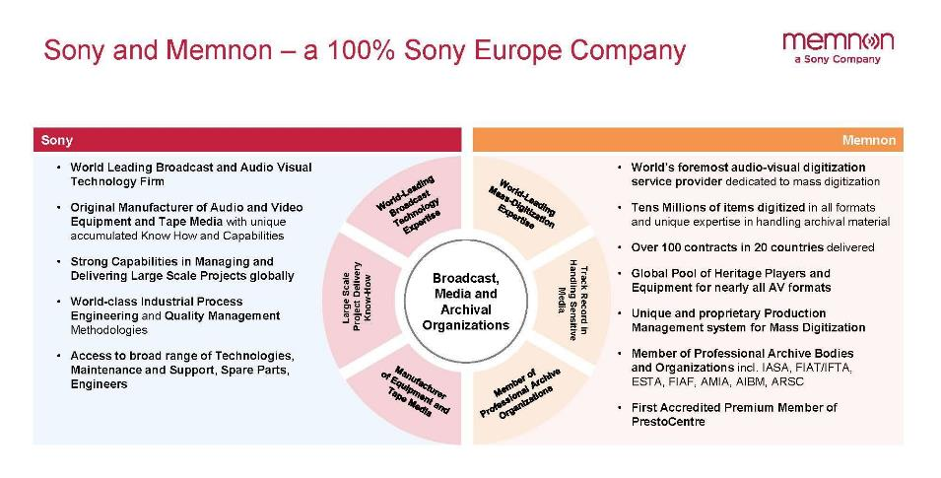
©2017 Memnon Archiving Services SA. All rights reserved.
3

Slide 41

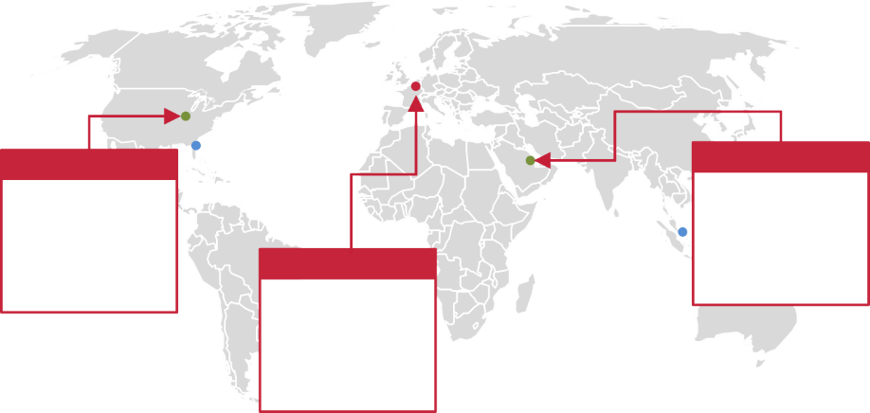



A WIDER GLOBAL NETWORK
Sales & Client Teams in Brussels, Basingstoke, Bloomington, Miami, Dubai & Singapore
Dedicated Sales & Client Teams Memnon Delivery Sites
On-Site Projects
Headquarters
Plus On-Site Customer Projects: Qatar, SABC in South Africa and new client sites in 2017
US, Indiana
UAE , Dubai
Memnon USA, Main Delivery site for North
and Latin America
Belgium, Brussels
Memnon @ Sony Professional Middle East in Dubai (currently Audio, Limited Video capacity)
Memnon Headquarters and Main European Delivery Site
41

Slide 42












OUR EXPERIENCE: MEMNON’S TRACK RECORD
Memnon helped a wide range of customers with Prestigious Archives and Invaluable Content to digitize
their archives. Clients include world renown National Archives, Broadcasters, Organizations etc.
Over 2.5 mil hours and 5 mil carriers
of content digitally preserved
Example of Clients
Hours of Content Digitized
Public Broadcaster in Qatar 34,000 Films
United Nations International Crime Tribunal 62,000h Audio & Video
French National Audio Visual institute 30,000h Audio and Video
Finish National Audio Visual Archive 25,000h Video
Portuguese Radio & TV 44,000h Audio
International Olympic Committee
30,000h Audio and Video
Imperial War Museum London
30,000h Video
avt/Sveriges Radio Förvaltnings 100,000h Video
French National Library 375,000h Audio & Video
VRT Belgian Radio & TV 58,000h Audio
Media Digitization and Preservation Initiative https://mdpi.iu.edu/
Over 300,000h, 25,000 reels of film Audio, Video, Film
Swiss Radio & TV 86,000h Audio & Video
Danish Radio 350,000h Audio
Belgian Francophone Radio/TV Archive 72,000h Audio and Video
BBC
23,000 Tapes
2005
2017
42

Slide 43
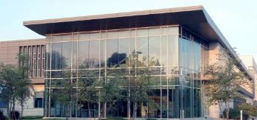
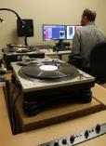
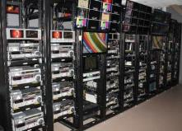
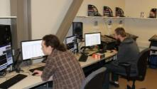
MEMNON ARCHIVING SERVICES, BLOOMINGTON
Located in the Indiana University Innovation Center, a Silver LEED rated building
Co-located with Indiana University’s MDPI studios
Memnon space completely remodeled in 2015
Memnon installed more than 30,000 feet of CAT 6E, 10,000 feet of Hi Def COAX, 10,000 feet of balanced audio cable
The facility has three sources of power with a dedicated 50 kVa Power Distribution Unit for all digitization equipment
Multiple data networks including two high speed 10 Gbs fiber optic connections
Rolled marmoleum floors to reduce the potential for static electricity and provide a clean, dust free environment
Multiple studios are designed to be easily repurposed and allow allocating the required number of ingest lines for a given format depending on volumes and time constraints.
©2017 Memnon Archiving Services Inc. All rights reserved
6

Slide 44
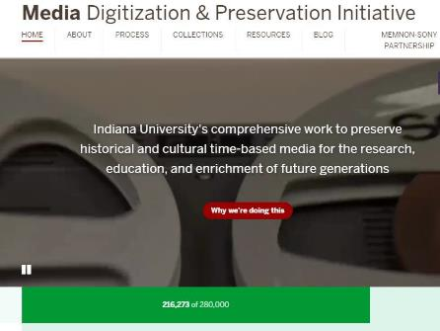
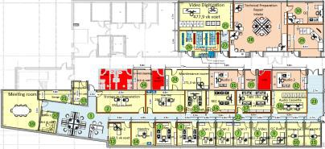
MEDIA DIGITIZATION AND PRESERVATION INITIATIVE
INDIANA UNIVERSITY
MDPI PROJECT
Completion by 2020
Over 280,000 various A/V media carriers, plus 25,000 reels of film
Production floor: 17,000 sq. ft.
Staff of 50
Current peak production (with further room
to expand):
  616 tapes/media carriers digitized/day
  27 TB/day
216,273 items to date
©2017 Memnon Archiving Services SA. All rights reserved.
7

Slide 45
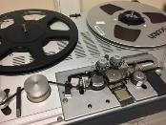

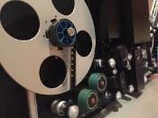
MEMNON BLOOMINGTON FORMATS
We currently digitize a range of formats and are constantly adding new ones as the need arises from our customers. We can also handle delicate or rare formats in collaboration with our partners at MDPI.
We fully customize to client specifications but typically deliver back a package of files to include a preservation master, mezzanine, access files with embedded metadata, plus XML and QC files.
Audio Video Film
¼ inch reel to
reel
Cassettes
DAT
CD
Grooved media (LP’s, 78’s,45’s, transcription discs)
1 inch open reel
Betacam family (SP, SX, Digital)
¾ inch U-Matic
VHS
DVCAM
D2
miniDV
Hi8
16mm
35mm
45

Slide 46
MEMNON’S CHOOSES THE RIGHT
PROCESS FOR THE MEDIA
Unitary Process (1 at a time)
78 rpm : short tracks, needle and amplification curve selection, possible needle jumps
Complex : 2’’ quad video tapes, film scanning, any items in bad conditions
Very short tapes
Low Parallel Processes (3-6 depending on format)
Good quality ¼’’ tapes with standard speed and track configuration
Average quality video cassettes (U-matic)
High parallel processes (depends on formats but can be 8 to 32, or use of robotics)
DAT
Average to Good Quality Audio Cassettes
Good Quality Video Tapes- BetaSP, VHS
46

Slide 47
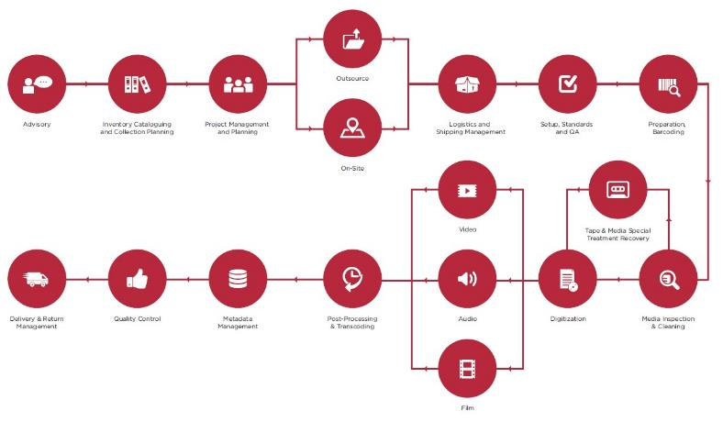

OUR SERVICE FLOW & TOOLSETS
MEMNON TOOLSETS
Memnon Workflow and Production Management System (Memnon PMS)
Memnon Cataloguing Platform (Catalyst)
Memnon Ingest (MIS)
Memnon File Management
system (MediaFeeder)
Memnon IPI Manager for Metadata generation and segmentation (IPI)
Memnon ScanManager for workflow logistics
Key Memnon tools developed by our in-house R&D subsidiary specifically for large scale digitization:
10

Slide 48
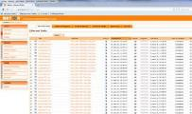
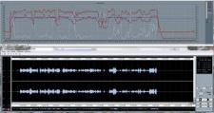
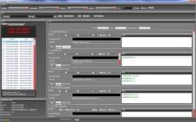
5 LEVEL QA/QC PROCESS
Standard Levels of Quality Control for Volume Digitization
QA/QC | Process Stage | Details
Level 1 | Preparation | Visual inspection during check-in Visual inspection during carrier preparation
Level 2 | Digitization | Machines are adjusted for each carrier 100% of files checked by digitization tools Flags/levels generated by equipment
Level 3 | File Analysis | Proprietary Tools and Workflow integration, e.g. Baton or BAVC QC tools for Video and NOA or Quadriga for Audio
Level 4 | Post Digitization | Operators check equipment generated flags Operators look for abnormalities Operators can flag a file for an additional check by the QC specialist (PBC)
Level 5 | Final QC and Statistical Control | Check all operator flags - PBC Check all equipment generated flags Check random samples using AQL Check metadata
Full Integration of 3rd Party Industry Standard Tools
Proprietary Quality Management Tools

Slide 49
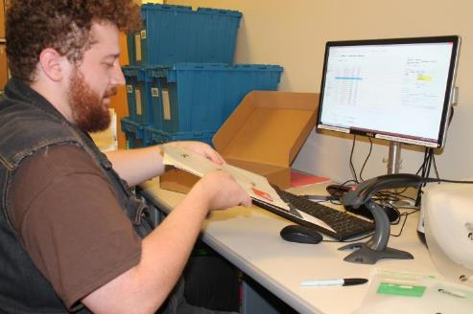
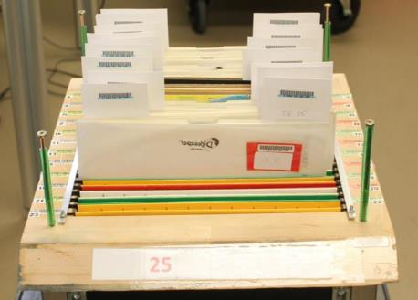
WHAT DOES PARALLEL TRANSFER LOOK LIKE IN ACTION?
Example: Grooved Media
Disc check-in
Re-sleeving
Visual inspection

Slide 50
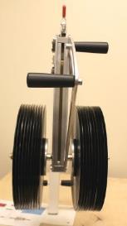
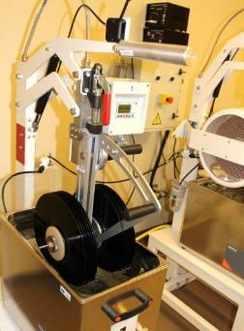
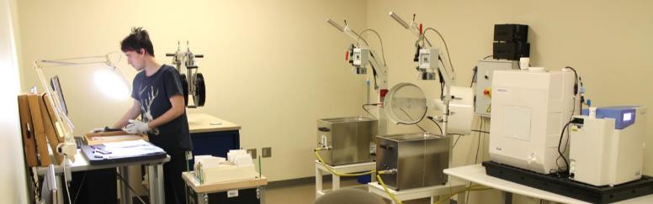
WHAT DOES PARALLEL TRANSFER LOOK LIKE IN
ACTION?
Example: Grooved Media
2nd Visual Inspection
PAM Tracking
Ultrasonic Cleaning

Slide 51
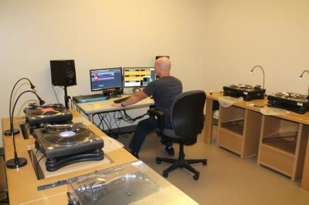
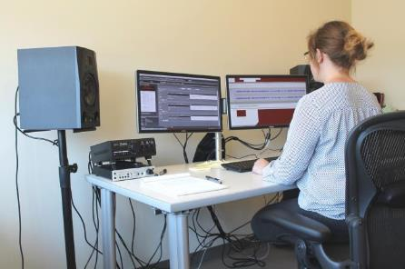
WHAT DOES PARALLEL TRANSFER LOOK LIKE IN
ACTION?
Example: Grooved Media
4 Digitization Work Stations
Multilevel Quality Assurance and Quality Control:
Combines human QC with automated and semi-automated QC

Slide 52
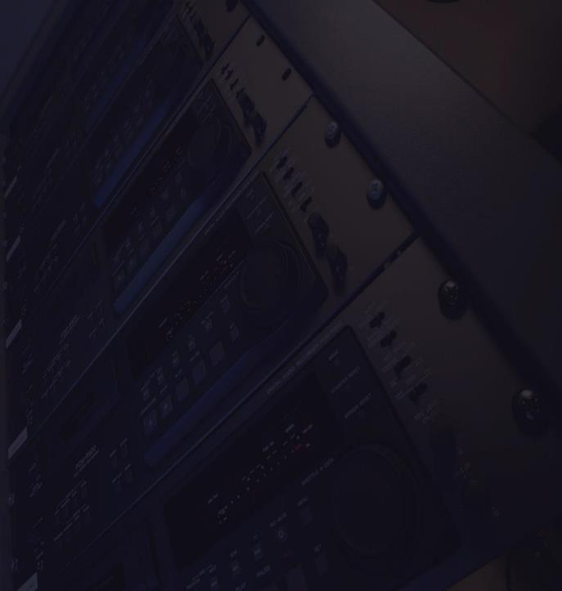
THANK YOU
Meet with us during these upcoming conferences:
Please reach out to us.
We are happy to share information about evaluating your media, best practices and provide quotes for services.
American Libraries Association Chicago, June 22
IASA
Berlin, September 17
Jan Jones, Business Development Coordinator jan.jones@memnon.com
(812) 856-6882
DLF/NSDA
Pittsburg, October 23
Memnon.com
Association of Moving Image Archivists (AMIA) New Orleans, Nov. 29

Slide 53
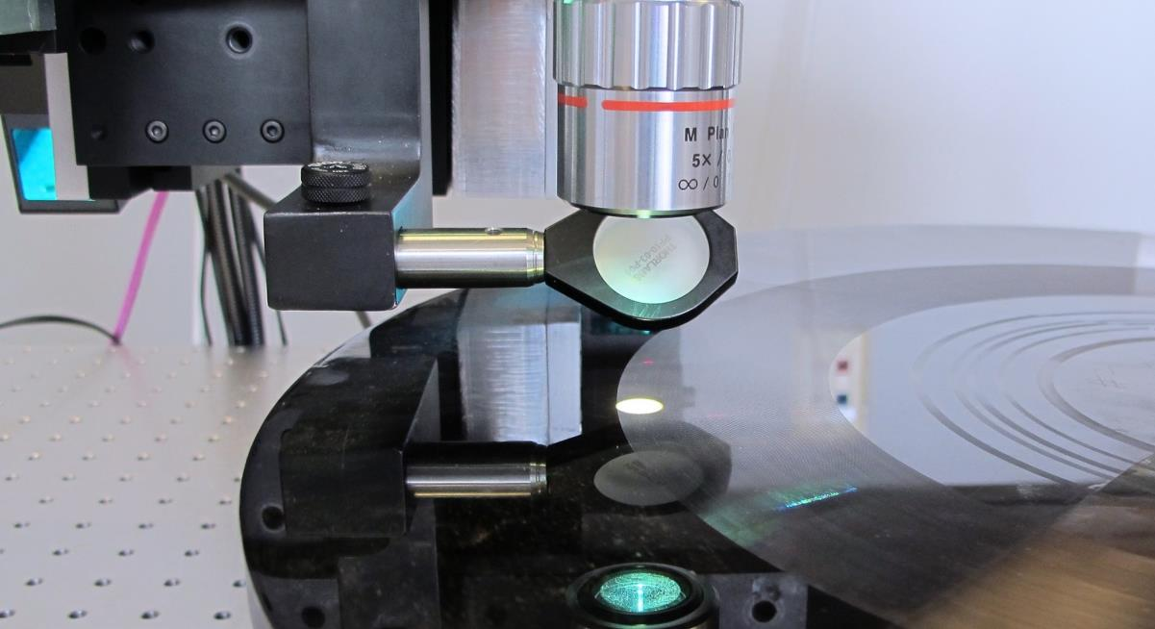

Bryce Roe
Manager, Audio Preservation Services
broe@nedcc.org

Slide 54

NEDCC is a nonprofit that serves collections-holding institutions nationwide by offering conservation treatment, digital imaging, audio preservation, assessments and consultations, training programs, disaster assistance, and free web resources.

Slide 55
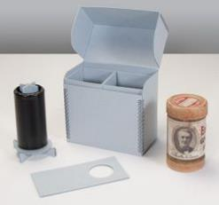
Audio Preservation Services
Conservation/Preservation
  Cleaning, re-housing, repair
  Digital imaging and conservation of original
  paper-based containers and related materials
Consulting
  Collection/item-level level assessments of audio holdings/carriers
  Workshops, webinars, “preservation leaflets” on audio preservation
Digitization and Reformatting….

Slide 56


Audio Preservation Services: Digitization
Magnetic and Optical Audio
¼” Open-reel audio tape
Compact cassette tape
Digital Audio Tape (DAT)
Compact Disc (CD)
Grooved Media
With IRENE
Lacquer disc
Aluminum transcription disc
Wax cylinder
Tin foil
Other rare formats
With Stylus
Metal master disc
Long-play (LP) vinyl disc
Shellac disc

Slide 57





IRENE
Non-contact approach
Able to digitize damaged, fragile media

Slide 58

Magnetic Audio
1:1 fully-attended transfers
100% quality control
Fully-informed consent: cleaning, conservation and rehousing options
Strict adherence to industry standards (IASA TC-04; FADGI)
Good candidates
Important collections where “stakes are high”
Fragile collections that are too risky to be transferred unattended
Clients who have no time/staffing to completely listen to deliverables

Slide 59
How to Approach NEDCC
Call or Email!
  Proposals are a consultation, not a price matrix
Physical examination or photos of carriers
  Secure, climate controlled storage
  No storage fees for pending projects
  Packing and shipping tips on website
Inventory or summary statistics
  We provide template with information we need to estimate cost
Website
  “About Audio” and “Working with Audio Preservation”
  Funding opportunities

Slide 60
Thank You! broe@nedcc.org
(978) 470-1010
@NEDCCInfo

Slide 61

Moderated Discussion

Slide 62
Moderated Discussion
“Need to know”
vs.
“Nice to know”

Slide 63
Moderated Discussion
What type of information is required when I first reach out to service providers?

Slide 64
Moderated Discussion
What type of information is required when I first reach out to service providers?
Format type(s)
Length of time in hours / # of items
Condition
Deliverables
Photos

Slide 65
Moderated Discussion
What type of information is required when I first reach out to service providers?
Parallel or 1:1 transfer?
Format type(s)
Length of time in hours / # of items
Condition
Deliverables
Photos

Slide 66
Moderated Discussion
What type of information is required when I first reach out to service providers?
Parallel or 1:1 transfer?
Format type(s)
Length of time in hours / # of items
Condition
Preservation masters
Deliverables
What types of files?
Production copy (mezzanine)
Photos
Access copies

Slide 67
Moderated Discussion
What advice can you give re: seeking out and identifying the most “qualified” service provider?

Slide 68
Moderated Discussion
What advice can you give re: seeking out and identifying the most “qualified” service provider?
Best practices = compare 3 proposals
Do your homework: check relevant guidelines (FADGI, IASA, …) for info on deliverables

Slide 69
Moderated Discussion
What type of infrastructure should my institution have in place before we seriously consider digitization of A/V assets? Is there a minimum viable digital preservation plan we should aim for?

Slide 70
Moderated Discussion
What type of infrastructure should my institution have in place before we seriously consider digitization of A/V assets? Is there a minimum viable digital preservation plan we should aim for?
Storage
Fixity
Security
Metadata
File Formats

Slide 71
Moderated Discussion
What are some strategies and/or important considerations for when I am prepping materials to go to service provider?

Slide 72
Moderated Discussion
What are some strategies and/or important considerations for when I am prepping materials to go to service provider?
Manifest

Slide 73
Strategies for Audiovisual Digitization Projects
NEXT WEEK!
Low-Cost, DIY, and Community-Based Approaches to Audiovisual Digitization
Wednesday, June 21, 2017 @ 2 PM ET
Moderator:
Wayne Graham
Technical Director, CLIR
Kathy O’Regan
Bay Area Video Coalition
kathyoregan@bavc.org
Diana Little
The MediaPreserve
little@themediapreserve.org
Jan Jones
Memnon Archiving Services
jan.jones@memnon.com
Bryce Roe
Northeast Document
Conservation Center
broe@nedcc.org

