Slide 1
DLF-Jisc Pilot Project webinar
23 March 2018

Slide 2
Welcome and introductions
Overview of IRUS-USA pilot project and progress to date
DLF Assessment Interest Group (DLF-AIG) connections and interests

Slide 3
https://jusp.jisc.ac.uk/irus-usa/
Login: guest@clir.org
Pw: statsRus

Slide 4
IRUS-USA Pilot Partners
University of Pittsburgh
Montana State University
Indiana University
University of Maryland
University of Houston
Cal Tech
University of Virginia
Swarthmore College
University of Michigan
Smithsonian Libraries
Johns Hopkins University

Slide 6
Institutional Repository Usage Statistics (IRUS)
A national aggregation service, enabling IRs to share/expose usage statistics at the individual item level, based on a global standard – COUNTER
Collect raw download data from IRs for all item types within repositories
Process those raw data into COUNTER-conformant statistics

Slide 7
How?
Tracker Protocol
Data ingest and processing:
QA processes
Data access and presentation:
Web, SUSHI, SUSHI Lite API

Slide 8
Notes:
Jisc

Slide 9
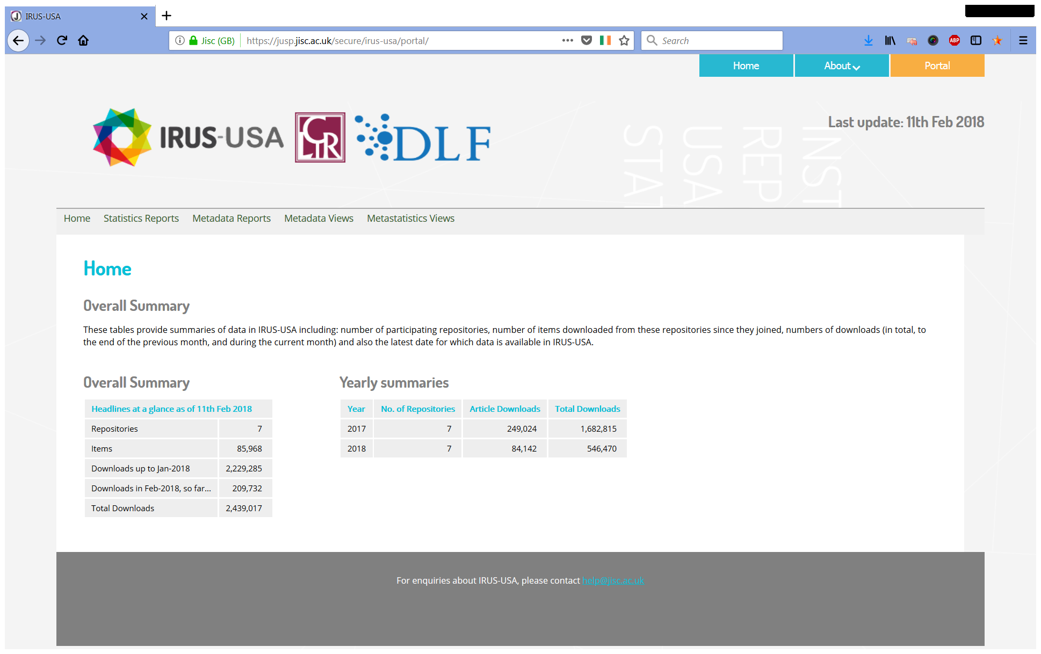

Slide 10
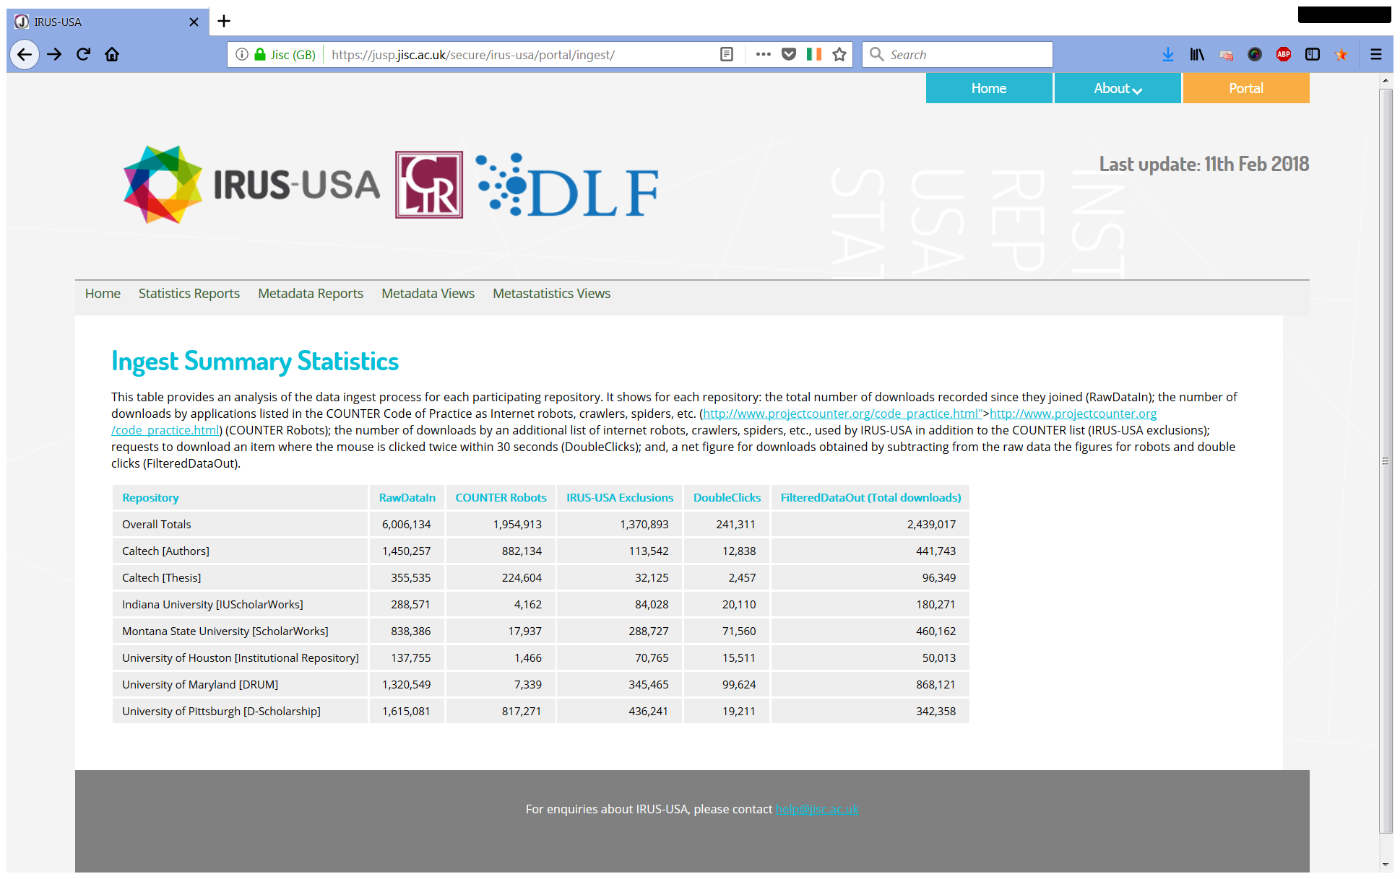

Slide 11
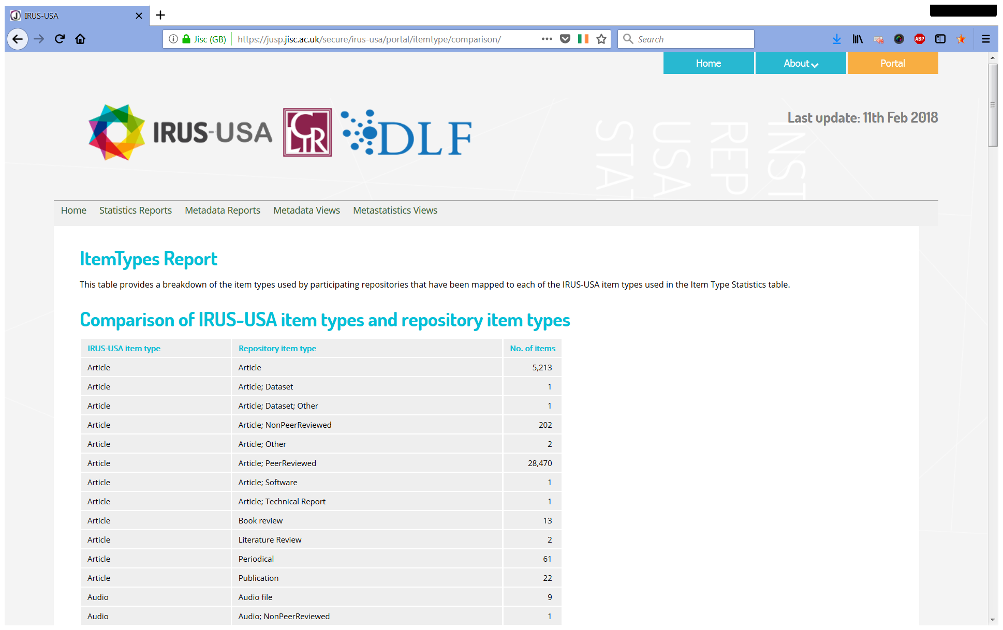

Slide 12
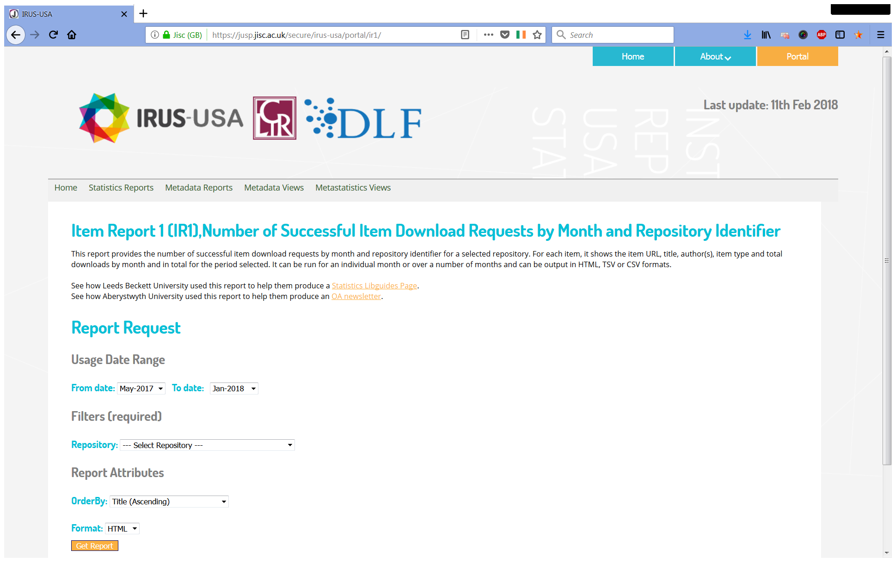

Slide 13
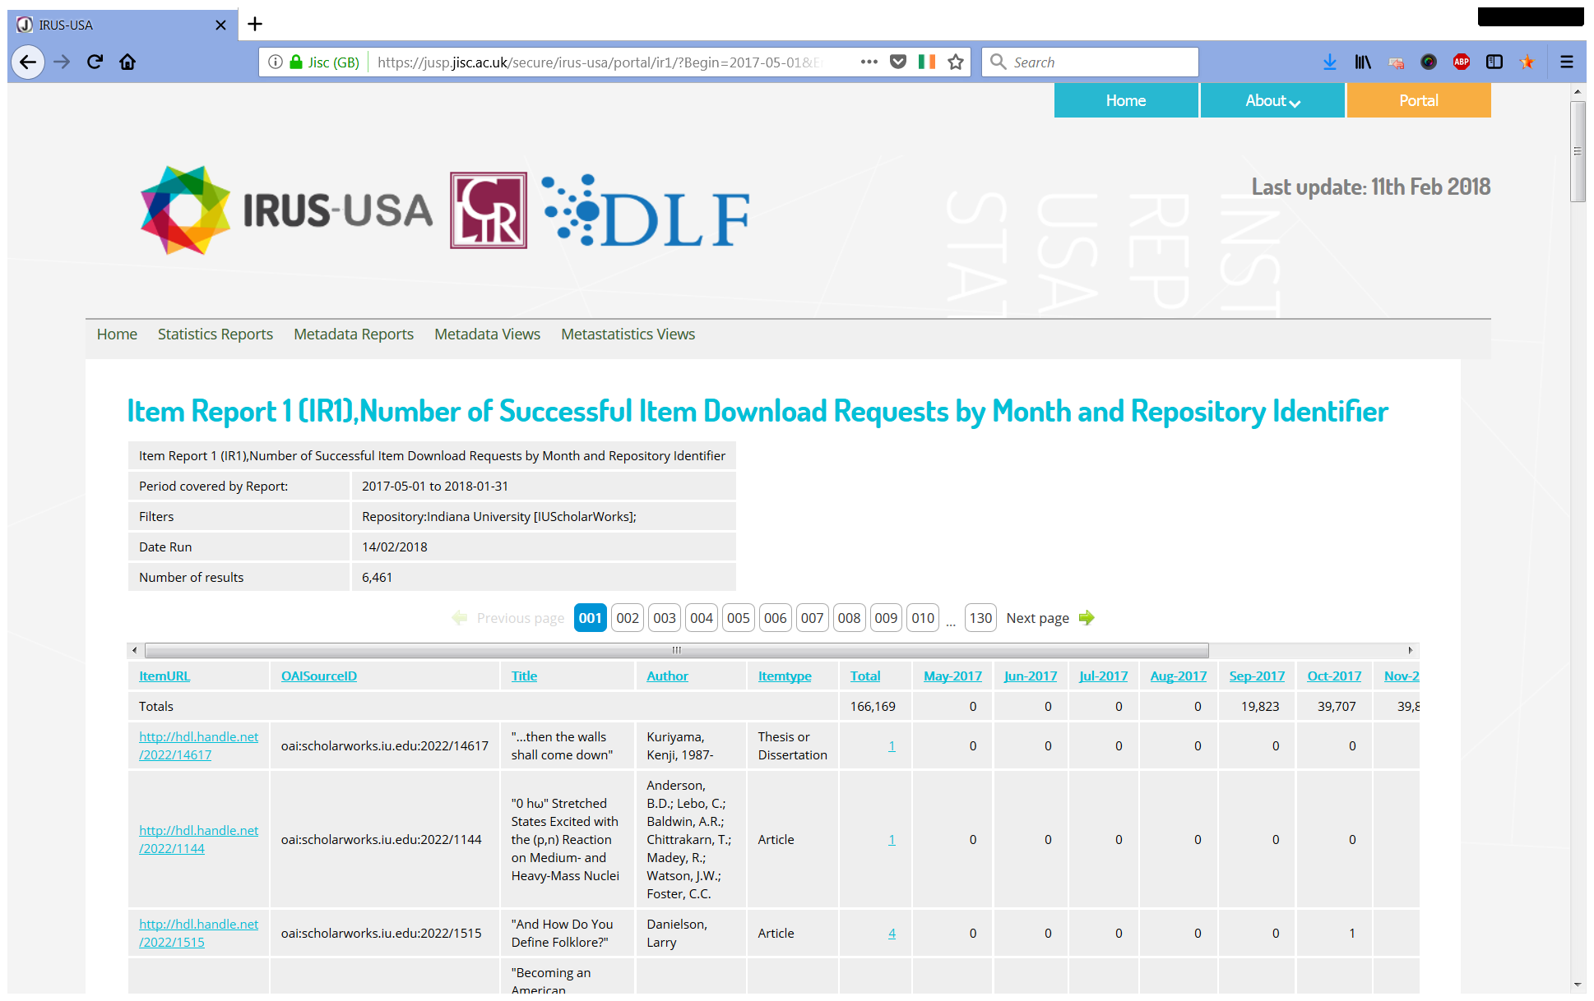

Slide 14
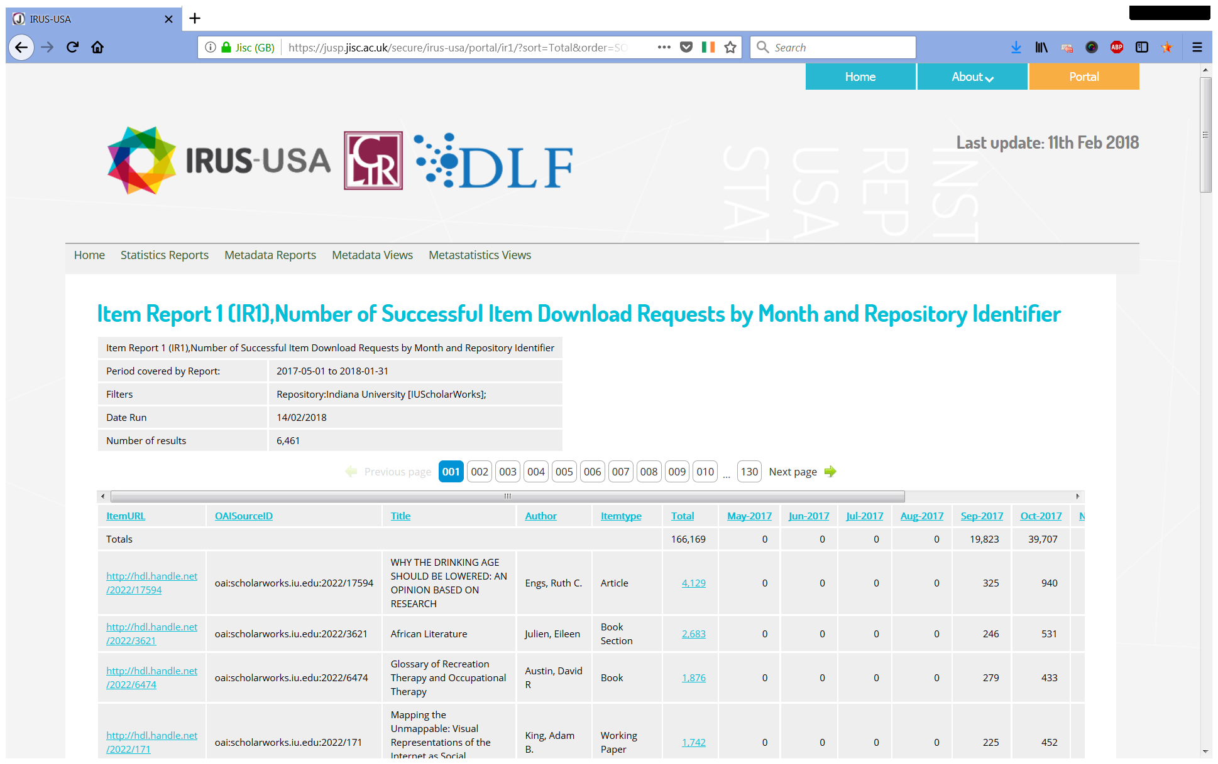

Slide 15
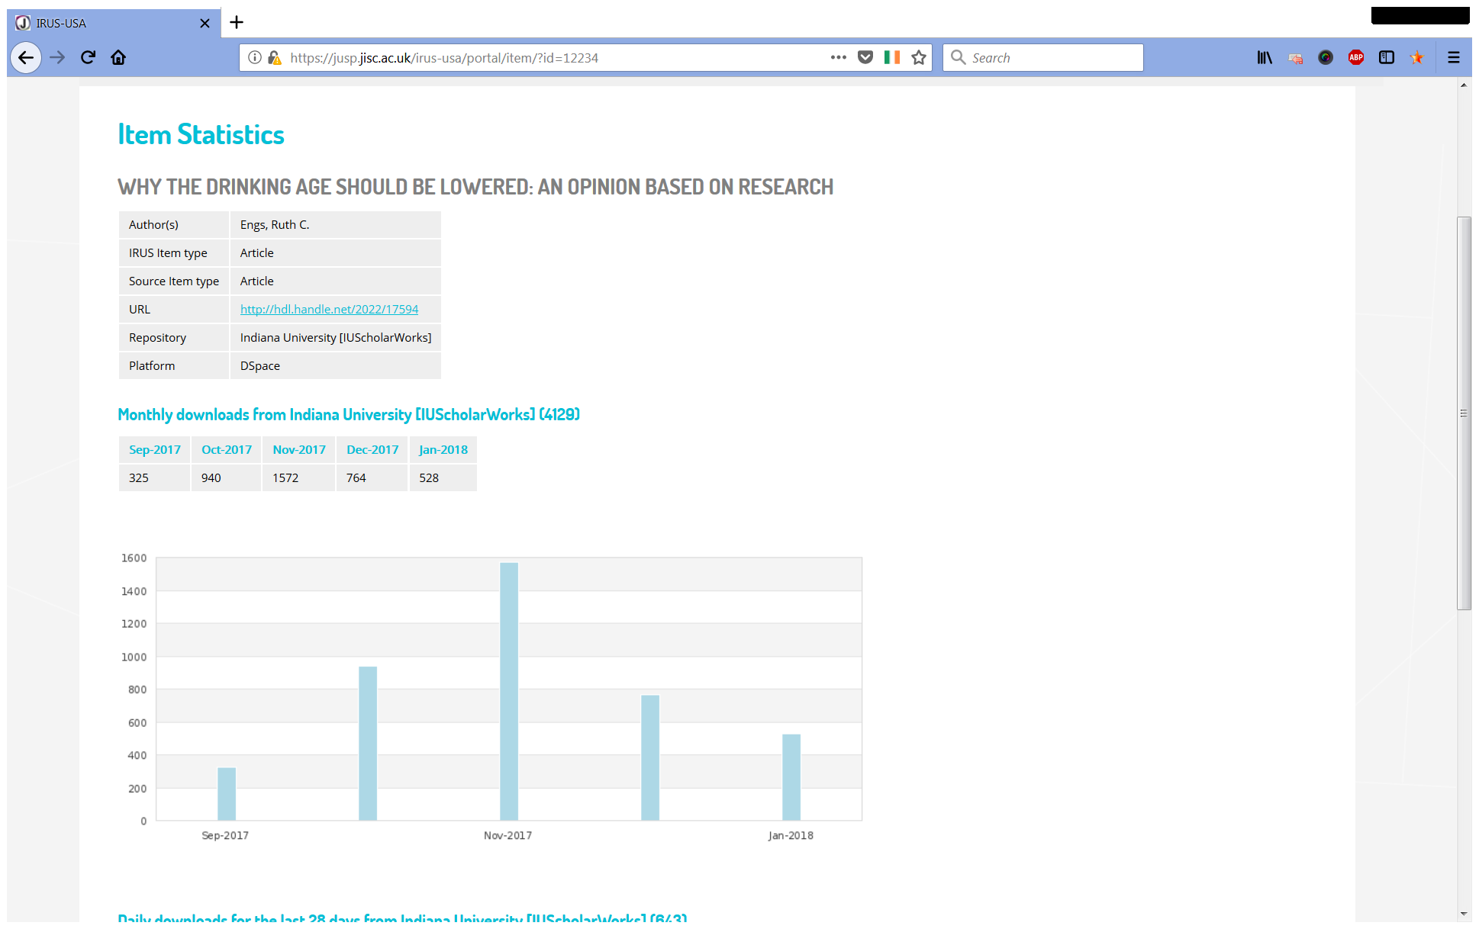

Slide 16
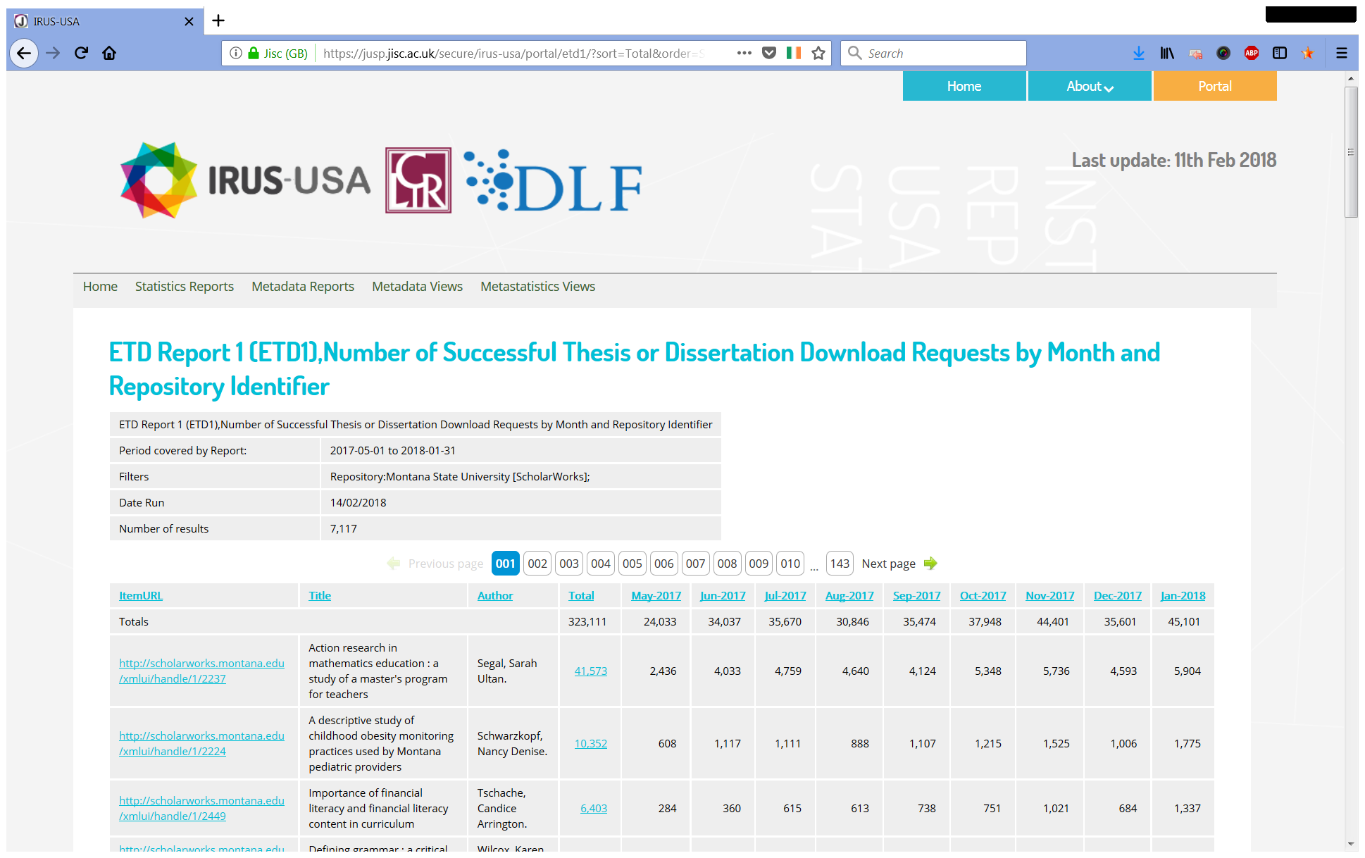

Slide 17
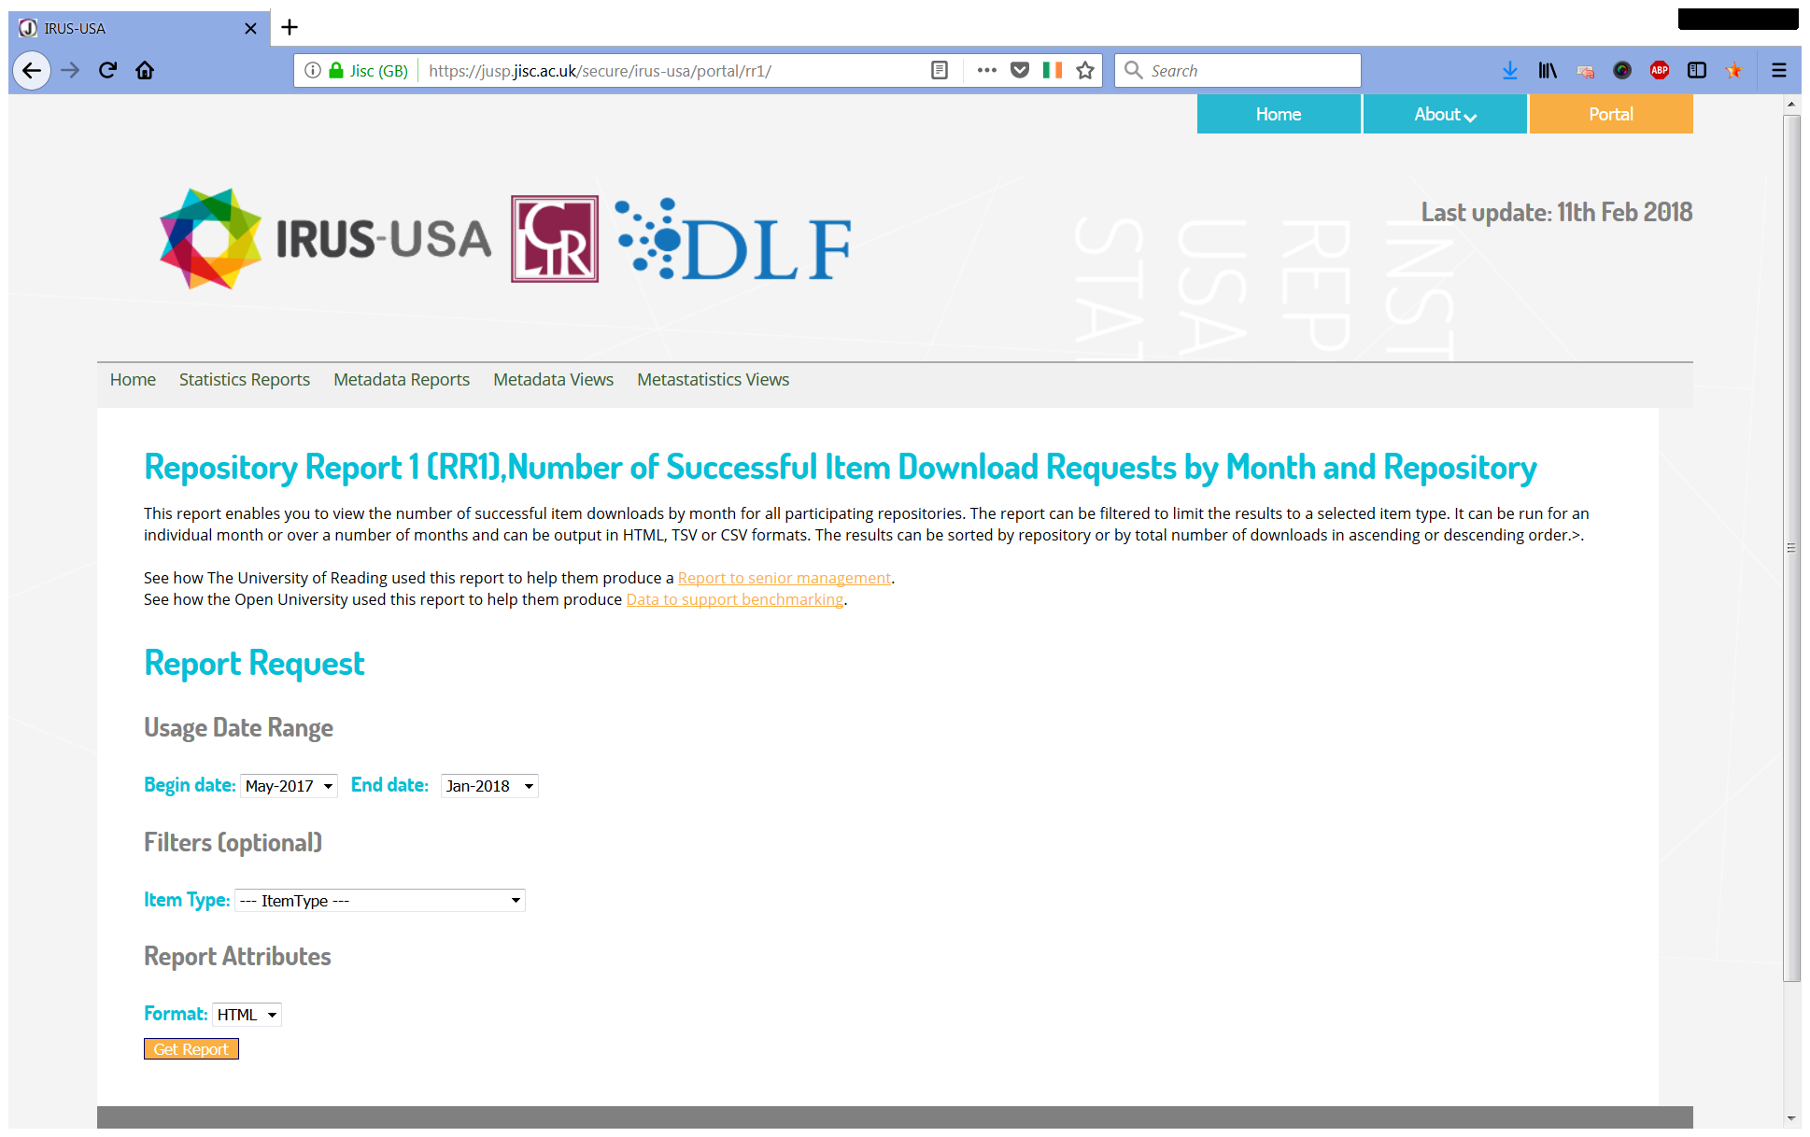

Slide 18
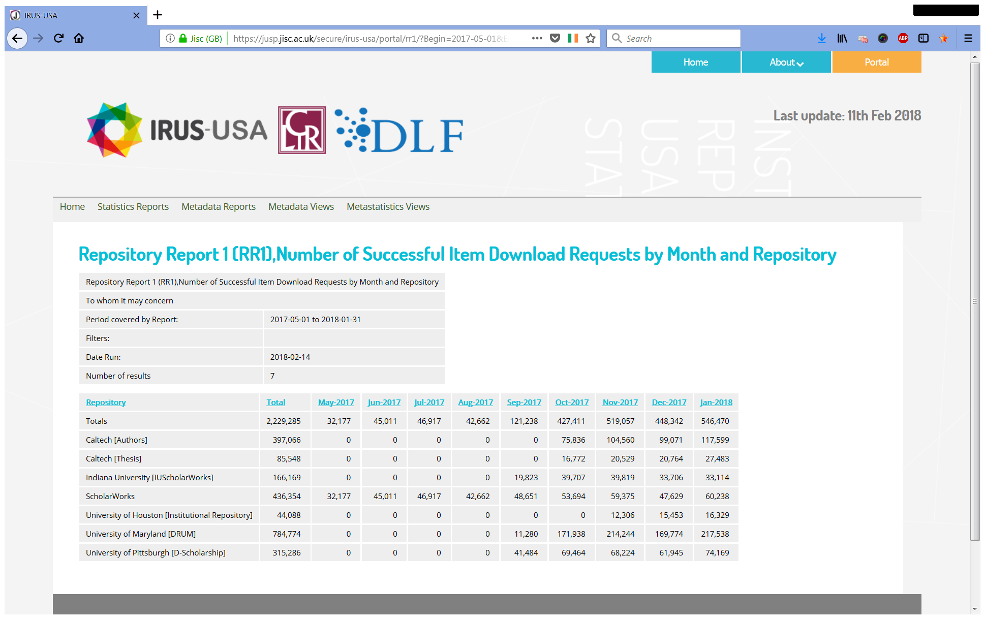

Slide 19
What’s next for IRUS?
Visualisations - Tableau
COUNTER R5
Enhanced metadata
ORCIDs
Funder details
Pilot services

Slide 20
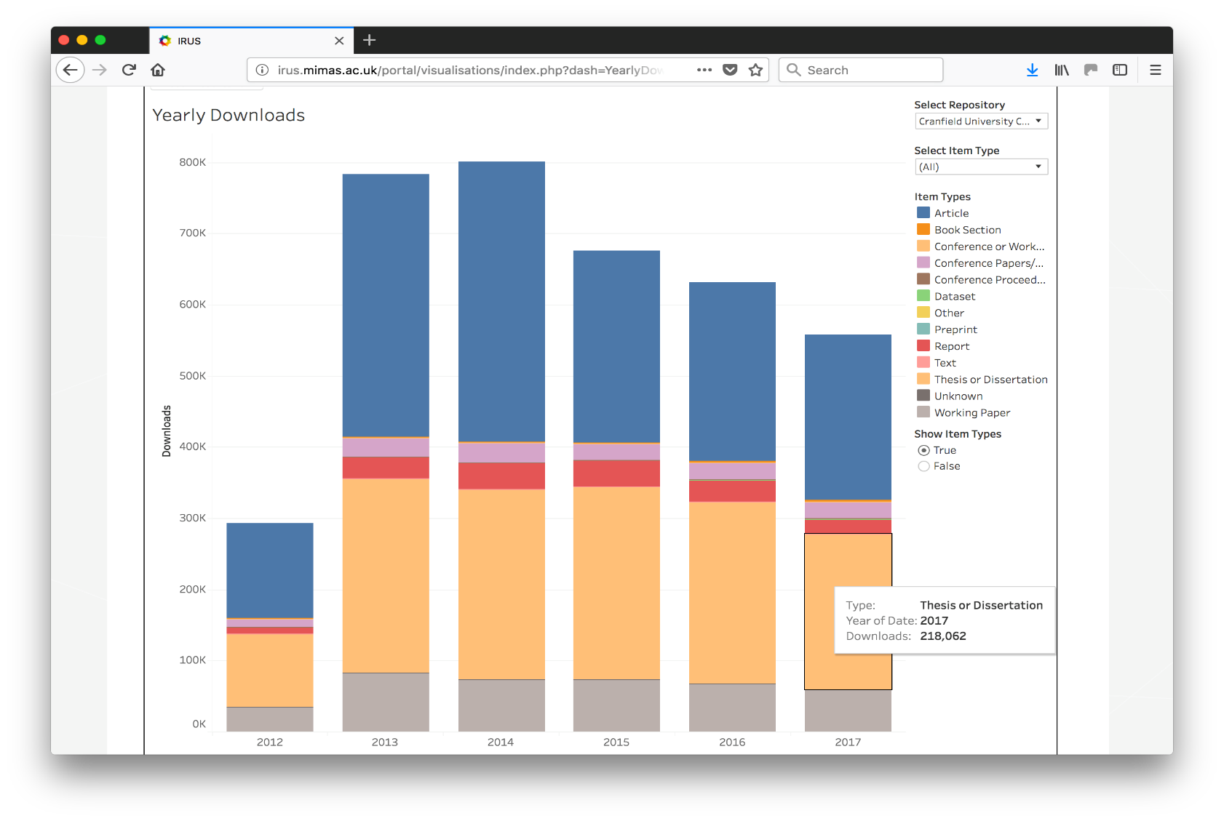
Visualisations – Yearly Downloads

Slide 21
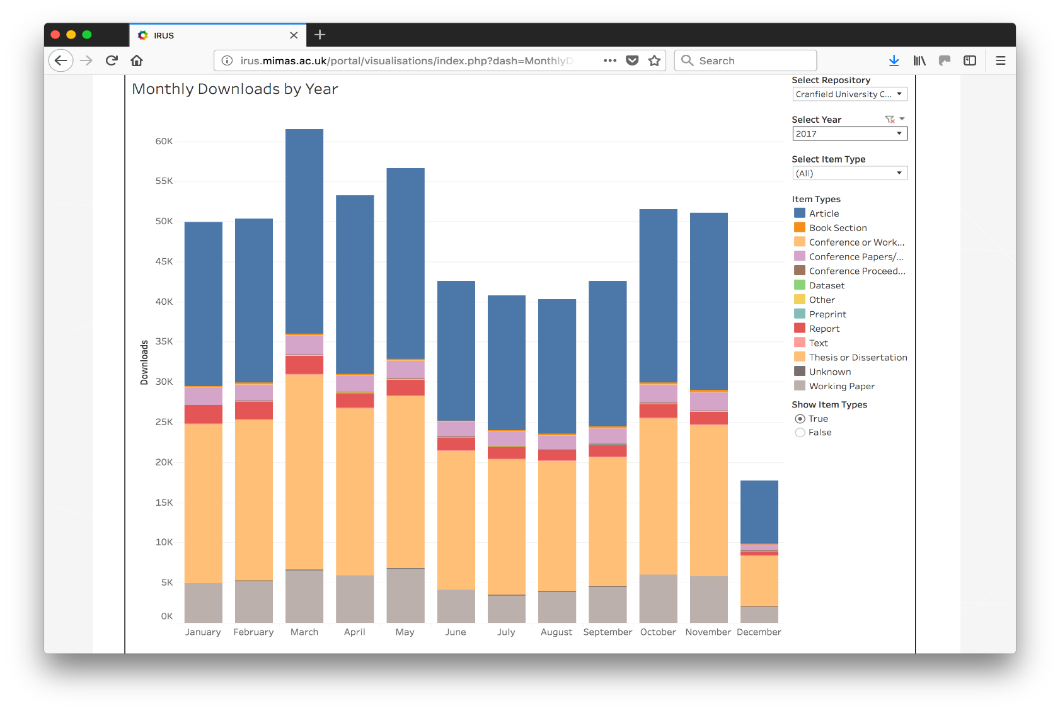
Visualisations – Monthly Totals

Slide 22
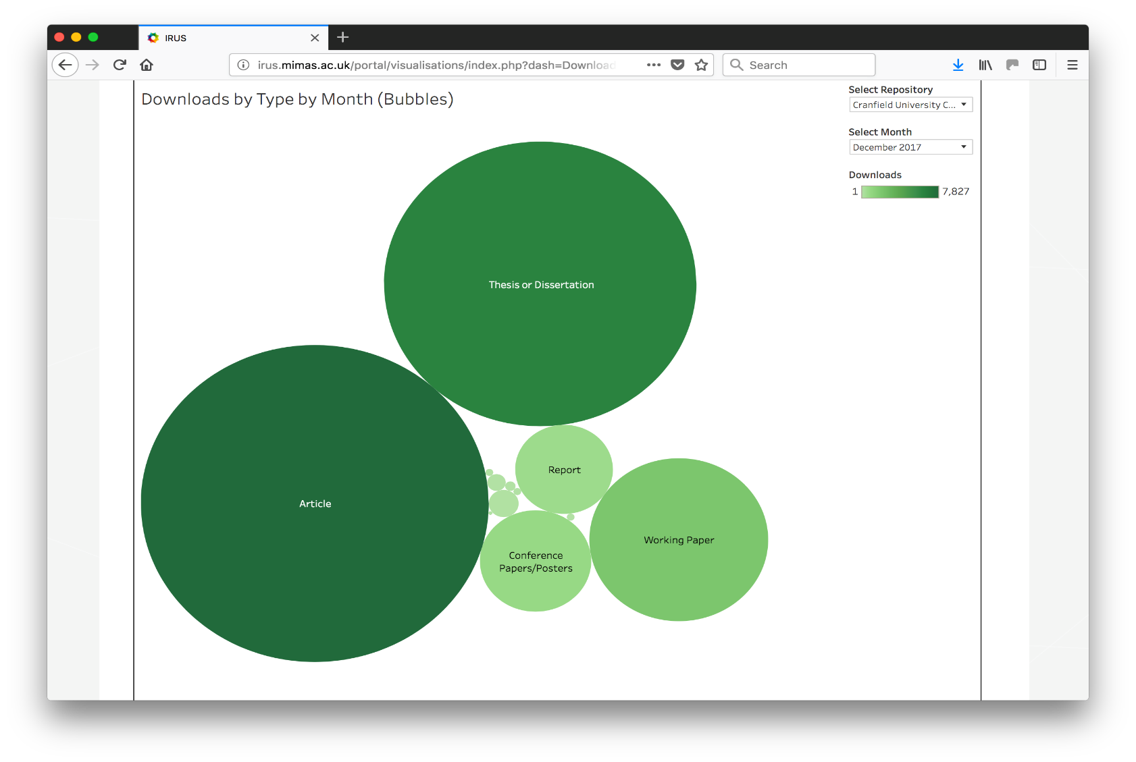
Visualisations – Downloads by Month

Slide 23
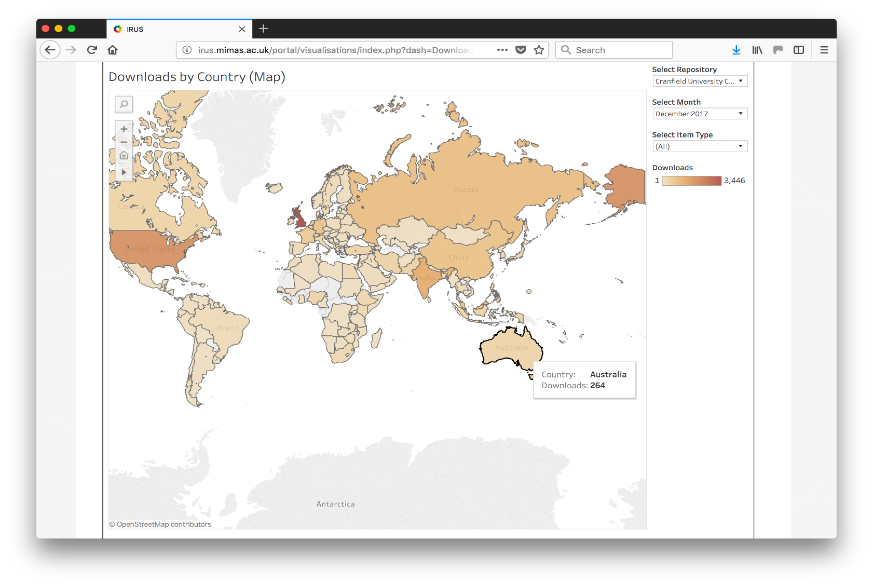
Visualisations – Downloads by Country

Slide 24
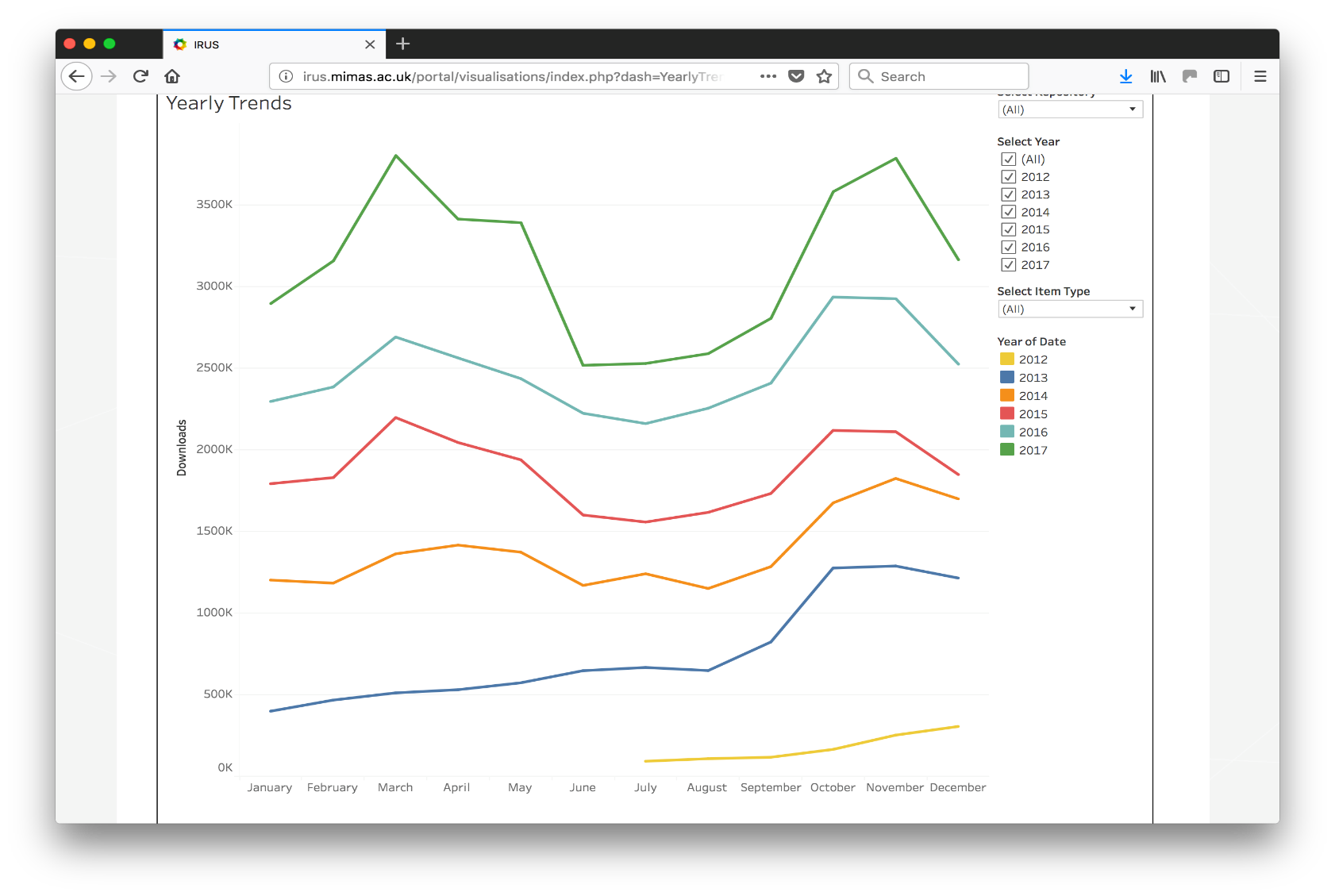
Visualisations – Yearly Trends

Slide 25
What’s next for IRUS?
Visualisations - Tableau
COUNTER R5
Enhanced metadata
ORCIDs
Funder details
Pilot services

Slide 26
Why IRUS?
Data
COUNTER-conformant
Consistent & comparable
Filtered to remove anomalies, robot and rogue usage
Service
Helps identify trends and patterns of usage
Supports comparison & benchmarking across organisations, nationally and internationally

Slide 27
Stakeholders & selected use cases
Repository manager | Researcher | Funders and policy makers | Suppliers of related products | International initiatives | OA publishers
I want to…
Identify trends and patterns in usage Report to management Benchmark my IR performance against a national picture | Monitor usage and impact of my research Report usage of my research to my funding body | Monitor the transition to OA Assess impact of new policies Demonstrate impact of funded research | Consume usage statistics for presentation in my product Utilise Robots exclusion list as a basis for developing my stats | Interact with a national aggregator providing a single point of transfer for usage stats | Collate and aggregate usage stats from various platforms
Status
Current | Current | Future | Current/future | Current | Future

Slide 28
IRUS-USA Pilot Questions
Is there an appetite for a national or North American regional service like this among DLF’s membership?
Are IRUS-UK use cases broadly applicable internationally?
Does the community see value in comparing statistics across US-based institutions? On an international basis? At “special” moments or in advocacy contexts like OA Week?

Slide 29
IRUS-USA Pilot Questions
What barriers might exist to implementation/participation? Technically? In terms of demonstrating value to stakeholder communities? How could we do better?
What assessment methods could best determine the value of a service like IRUS-USA and contribute to its optimization?

Slide 30
IRUS-USA Pilot Questions
Can we usefully align this work with DLF-AIG and wider DLF community projects and interests? (e.g. RAMP, AIG “Re-use,” and DLF Dashboard projects)
How might DLF and Jisc work together to make an IRUS-USA service sustainable?

Slide 31
Your Questions and Feedback

Slide 32
http://bit.ly/IRUSsurvey
info@diglib.org
help@jisc.ac.uk: please mention IRUS in either the title or body of your email.
Notes:
Webinar response survey

